Slide 1


INTROUCTION
TO
ECONOMICS
Made by:
Name: Sachin Devdhar
Class: SY IT 1
Enrollment no.: 160410116001
Guided by: Prof Disha Patel

Slide 2

CONTENTS:
History of Economics
Definitions of Economics
Scope of Economics
Difference between Micro and Macro Economics
Nature of Economics
Case Study: Current account deficit

Slide 3
History of Economics
Derived from a Greek word ‘okionomia’, ‘meaning management of house affairs’.
Nowadays, ‘okionomia is used for an economy as whole in the sense that how a nation takes steps to fulfill its desires and preferences with the help of scarce means.
Its also termed as ‘Political Economy’.

Slide 4
Definitions of Economics
According to Lionel Robbins, Economics is science which studies human behaviors as a relationship between ends and scarce means each have alternative uses.
According to Adam Smith, It is science that inquires into the nature and causes of wealth of nation.

Slide 5

Scope of Economics
Development economics
Microeconomics
Macroeconomics
International Economics
Environmental Economics
Urban and rural economics

Slide 6
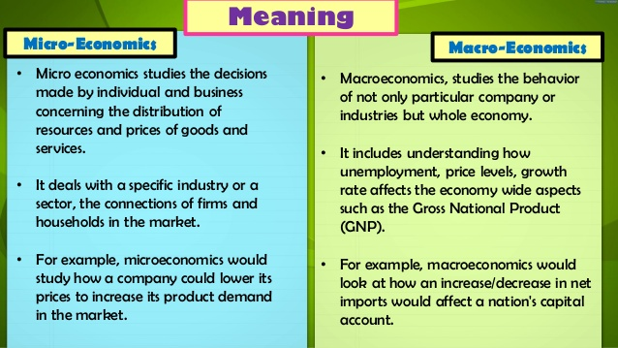

Slide 7
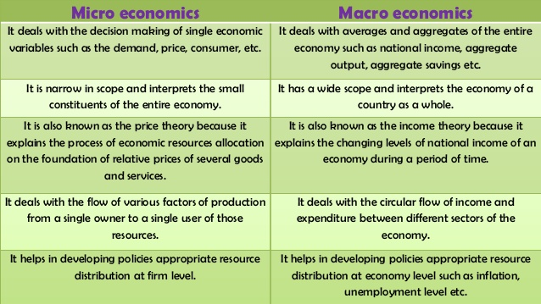

Slide 8
INTERACTION
Looking at the differences, it appears that these two studies of economics are different but in reality they are inter-related and complement each other since the issues that they address are overlapping.
For example, increased inflation (a macroeconomic effect) would increase the prices of raw materials required by the companies to manufacture products which would in turn also affect the price for the final product charged to the public.

Slide 9
When we talk about macroeconomics while studying the constituents of output in nations economy we also have to understand the demand of single households and firms, which are micro economic concepts.
Similarly when we study the investment policies of businesses- a micro economic concept we cannot do it without learning about the effect of macroeconomic trends in economic growth, taxation policies etc.

Slide 10
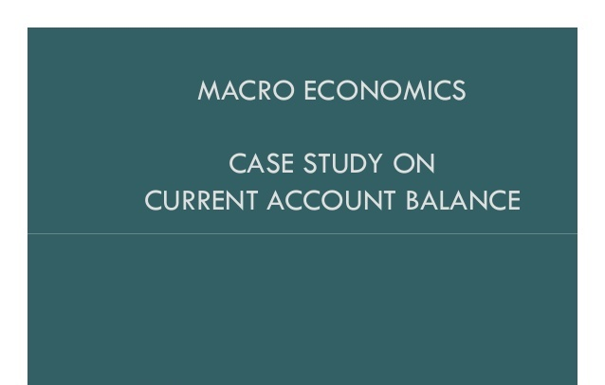

Slide 11
Objective of the Case Study
To find out how a country’s current account balance is equal to the difference between it ’s saving and investment?
Examine this relationship with regard to India for the last four decades.

Slide 12
Current Account Balance
Current Account Balance (includes all current transactions )is a measure of country’s transactions with respect to the rest of the world.
Current account balance , CA = S – I .
If CA +ve, it measures the portion of a country's saving invested abroad;
If CA –ve, measures portion of domestic investment financed by foreigners 'savings.

Slide 13
A current-account surplus is not always a sign of health; a current-account deficit is not always a sign of weakness.
Current-account surplus excess of domestic savings over domestic investment which could reflect a lack of domestic investment opportunities.
Current account deficit reflect a low level of national savings relative to investment or a high rate of investment—or both.

Slide 14
The Solution
We have to derive that Current Account Balance = Savings – Investment.
Current account is the difference between what a country produces (GNP) and what the country spends (total consumption plus investment).
In fact: GNP = C + I + G + NX .................................... (1)
C = Cd + Cf
G = Gd + Gf
I = Id + If (superscripts: d = spending on domestic goods f = spending on foreign goods) Where GNP is the income (the output generated by a country's enterprises whether located domestically or abroad)

Slide 15
The Solution
(Cd + Gd + Id) is domestic spending for consumption and investment purposes (formally called "absorption").
If a country produces more than it spends, the excess of goods produced must be net exported to the rest of the world (a positive external balance)
So, if GNP > Absorption, the external balance is positive or, equivalently, the current account is in surplus.
So, if GNP < Absorption, the external balance is negative or, equivalently, the current account is in deficit

Slide 16
From equation (1), we have NX = GNP – (C + I + G) ............................(2)
We know NX = EX – IM...............................(3)
From equation (2) & (3), NX = EX – IM = GNP – (C + I + G )
Trade surplus: output > spending then exports > imports Size of the trade surplus = NX
Trade deficit: spending > output and imports > exports Size of the trade deficit = –NX

Slide 17
Again, NX = (GNP – C – G ) – I = S – I Where Savings = (Income – Expenditure) S= GNP –C – G……………………..(4)
From equation (1) & (4), we get Current Account Balance, CA = S – I = NX
Current Account Balance = Savings – Investment = Part of Balance of Payments

Slide 18
Analysis
Since 1972-73 till 2011-12, India’s Current Account Balance has remained mostly negative. India’s National Savings has been less than National Investments except for 1975-76 to 1978-79 and 2001-02 to 2003-04.
The rate of Imports has always been on higher side in comparison to the Exports. Big jump in the Imports between the years 1978 - 1981 and 1985
2005 has brought the current balance to a big low. Since 2003-04, there has been a steady decline in the Current Account Balances, which has resulted in Current Account Deficit.

Slide 19
The impact of increase in Savings however was able to control the Current Account Deficit between the years 2002-2006 but could not control enough to save it from the deficit.
However, total savings declined from the peak of 36.8% in 2007-2008 to 32.3% in 2010-2011. As a result, the Current Account Deficit has been increasing. India’s Balance of Payment has been under stress during since 2004 as seen in graph as the trade and current account deficit widened.

Slide 20


